Slide 2
CONTENTS
1
ACID in Distributed Transaction
3
Solutions for Distributed Transaction
5
Eureka集群

Slide 3
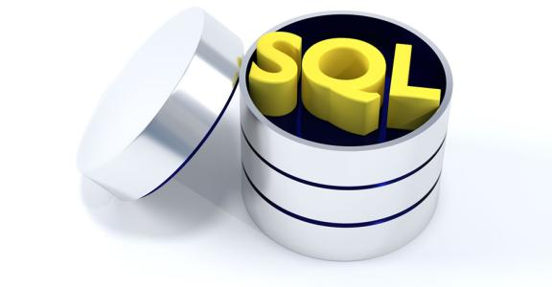
ACID in Distributed Transaction
1.What's ACID ?
“ACID (Atomicity, Consistency, Isolation, Durability) is a set of properties of database transactions intended to guarantee validity even in the event of errors, power failures, etc. In the context of databases, a sequence of database operations that satisfies the ACID properties is called a transaction. ” — — Wikipedia．

Slide 4

ACID in Distributed Transaction
“Atomicity guarantees that each transaction is treated as a single "unit", which either succeeds completely, or fails completely: if any of the statements constituting a transaction fails to complete, the entire transaction fails and the database is left unchanged. An atomic system must guarantee atomicity in each and every situation, including power failures, errors and crashes.” — — Wikipedia．
@Transactional public void placeOrder(Long userId,Long cost,Long orderId){ Long oldBalance = accountService.selectBalanceById(userId); if(oldBalance >= cost) { Long newBalance = accountService.reduceBalance(userId,cost); if(newBalance >= 0)
orderService.updateOrderStatus(orderId,"Approved"); } }
@?????????? public void placeOrder(Long userId,Integer cost,Long orderId){ Long oldBalance = restTemplate.getForObject("http://account/{id}/balance",
Long.class,new HashMap<>()); if(oldBalance >= cost) { restTemplate.put("http://account/{id}/balance/{balance}",
new Object(),new HashMap<>()); restTemplate.put("http://order/{id}/status/{status}",
new Object(),new HashMap<>(); } }
local transaction
distributed transaction

Slide 5
ACID in Distributed Transaction
“Consistency ensures that a transaction can only bring the database from one valid state to another, maintaining database invariants: any data written to the database must be valid according to all defined rules, including constraints, cascades, and any combination thereof. This prevents database corruption by an illegal transaction, but does not guarantee that a transaction is correct.” — — Wikipedia．
@Transactional public void placeOrder(Long userId,Long cost,Long orderId){ Long oldBalance = accountService.selectBalanceById(userId); if(oldBalance >= cost) { Long newBalance = accountService.reduceBalance(userId,cost); if(newBalance >= 0)
orderService.updateOrderStatus(orderId,"Approved"); } }
@?????????? public void placeOrder(Long userId,Integer cost,Long orderId){ Long oldBalance = restTemplate.getForObject("http://account/{id}/balance",
Long.class,new HashMap<>()); if(oldBalance >= cost) { restTemplate.put("http://account/{id}/balance/{balance}",
new Object(),new HashMap<>()); restTemplate.put("http://order/{id}/status/{status}",
new Object(),new HashMap<>(); } }
local transaction
distributed transaction

Slide 6
ACID in Distributed Transaction
@Transactional public void placeOrder(Long userId,Long cost,Long orderId){ Long oldBalance = accountService.selectBalanceById(userId); if(oldBalance >= cost) { Long newBalance = accountService.reduceBalance(userId,cost); if(newBalance >= 0)
orderService.updateOrderStatus(orderId,"Approved"); } }
@Transactional public void placeOrder(Long userId,Long cost,Long orderId){ Long oldBalance = accountService.selectBalanceById(userId); if(oldBalance >= cost) { Long newBalance = accountService.reduceBalance(userId,cost); if(newBalance >= 0)
orderService.updateOrderStatus(orderId,"Approved"); } }
Thread A
Thread B

Slide 7
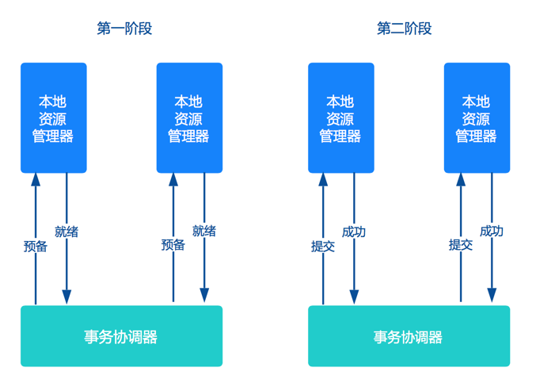
Solutions for Distributed Transaction
1. Two-Phase Commit
Libraries : Atomikos

Slide 8
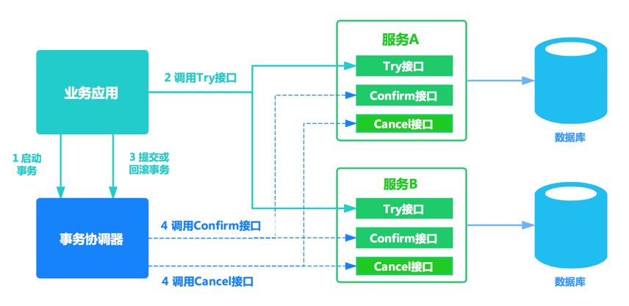
Solutions for Distributed Transaction
2 . TCC(Try、Confirm、Cancel)
Libraries : tcc-transaction、spring-cloud-rest-tcc

Slide 9
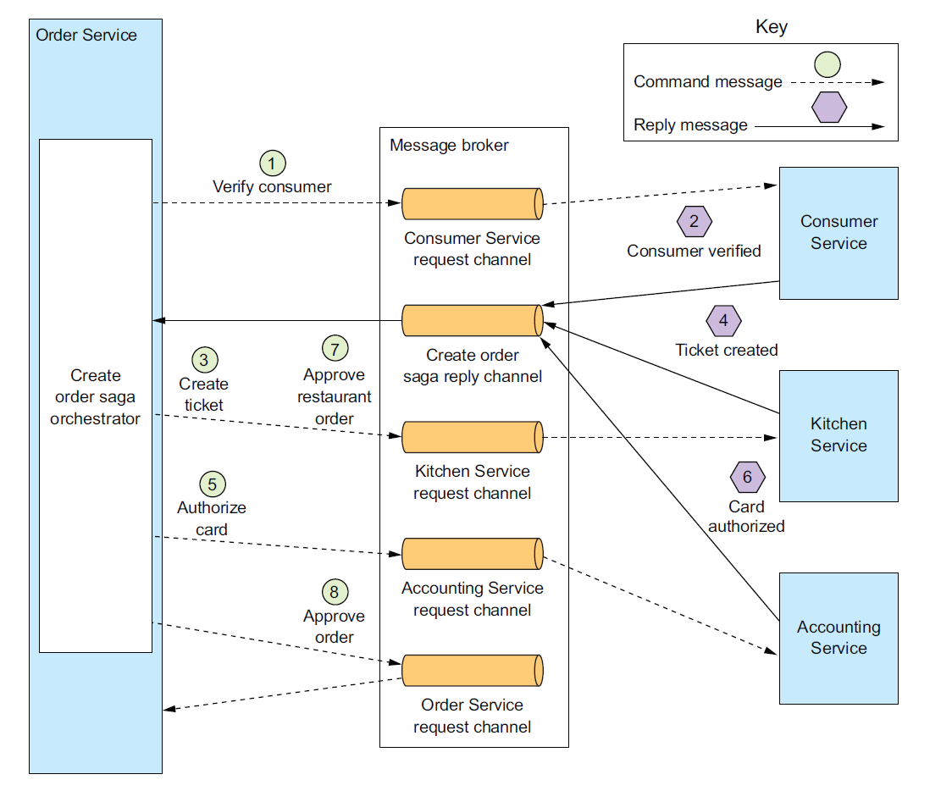
Solutions for Distributed Transaction
3 . Saga Pattern
Libraries : Servicecomb-Saga、Eventuate Tram

Slide 10

谢谢！

